Slide 1
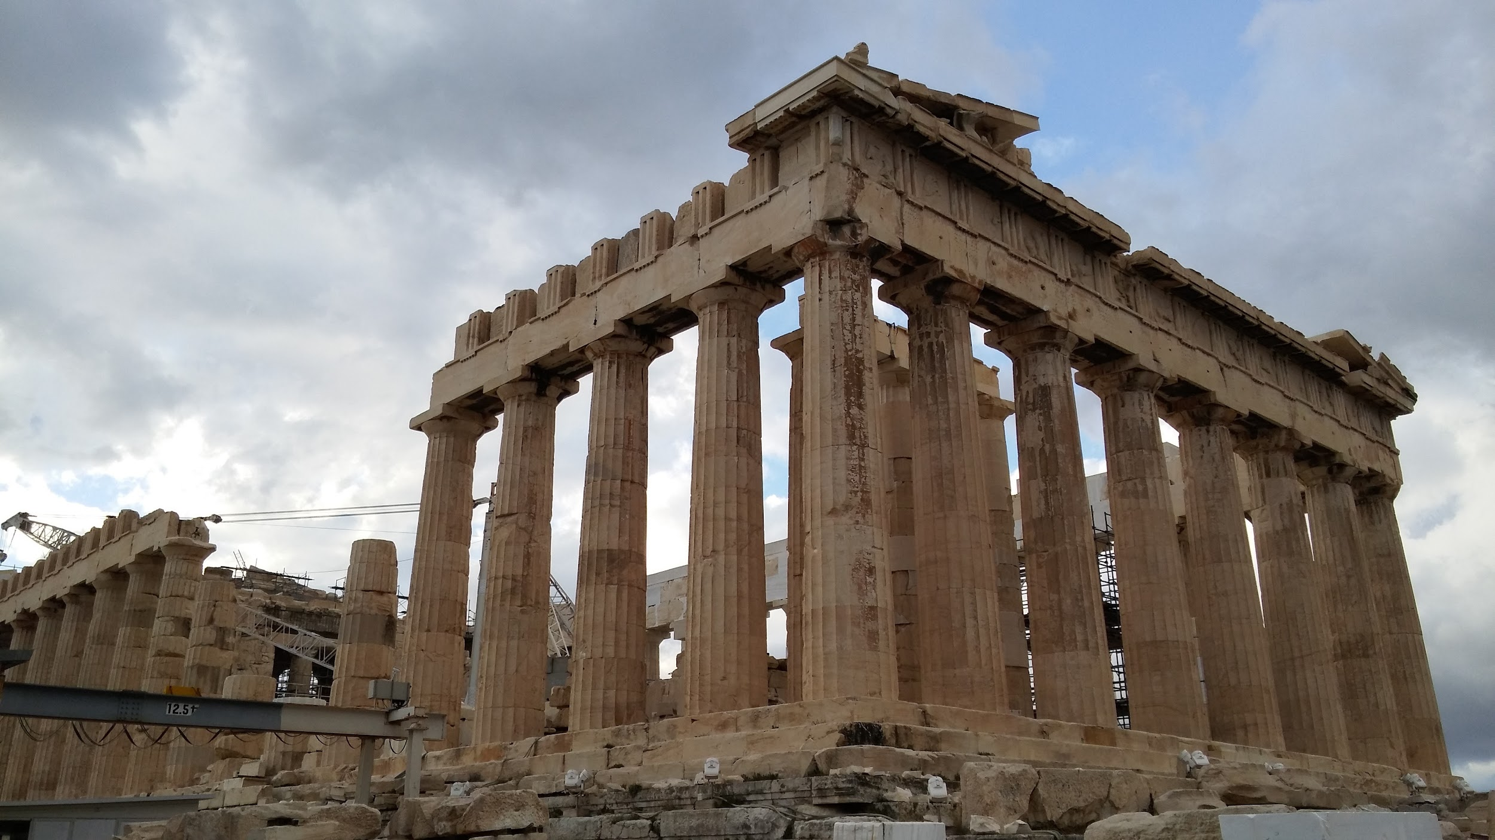
English The Three Little Pigs
Fiction- The children will enjoy sequencing the story and learning how to describe characters.
Non-Fiction- We will write a set of instructions.
Throughout our writing, we will incorporate Year 1 relevant spelling, punctuation, and grammar.
Year 1, Hedgehog class Term 1 2024-2025
Project question: What makes where we live special?
Concepts: Change, Community, Belonging
PSHE Being me in my world
We will be discussing feeling part of the class and school, develop our class charter, rewards and consequences.
RE
Why is belonging to God and the church family important to Christians?
We will look at different groups we belong to and use this as basis to explore Christianity. We will visit Smarden church to look for symbols of Christianity.
Science
This term we are observing Seasonal Change including completing charts of change over time.
We will be using scientific equipment to help with our observations and we will use units to put a numerical value to these observations.
Maths
Numbers to 10: Represent, compare and explore numbers within 10.
Addition and subtraction within 10: Represent and explain addition and subtraction.
Shape and patterns: Identify, describe sort and classify 2-D and 3-D shapes.
Numbers to 20: Identify, represent, compare and order numbers to 20.
DT Sculpture and 3D: Clay houses
Our brief is to design and create a house on a tile. We will take inspiration from features of houses in our local area and the work of the sculpture artist Rachel Whiteread.
Computing Technology around us
We will identify different technologies and their uses. We will develop skills that allow us to use computers and discuss how to stay safe on them.
History History of Smarden
We are exploring settlements and trade in our village, Smarden! Discovering similarities and differences since the 1950s. We will use various historical sources to gain information about life in the past.
Music Finding Our Singing Voices
We will explore our voices and learn about pitch and structure in songs.
PE Athletics
In PE, we will practise our running, jumping, throwing, and learning to compete against ourselves and others.

