Slide 1

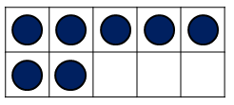
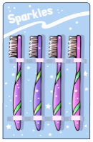
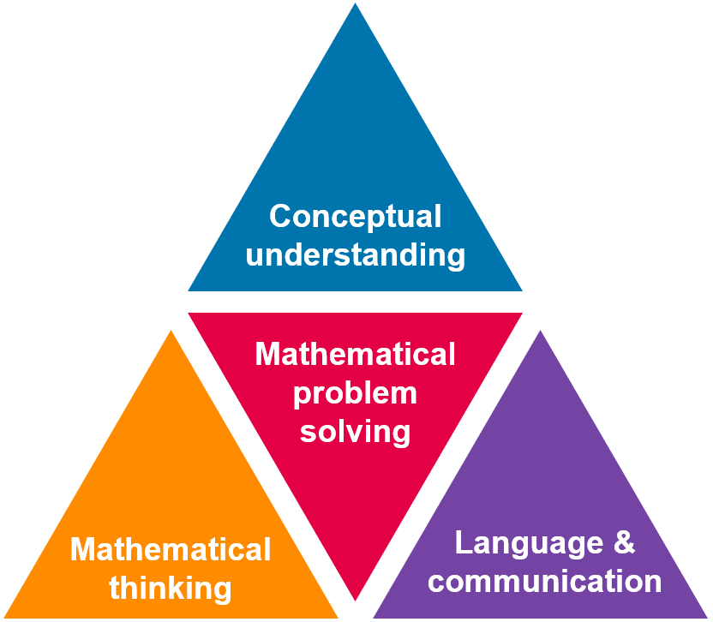

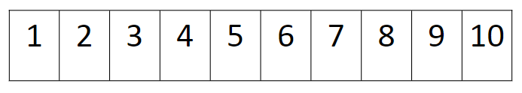
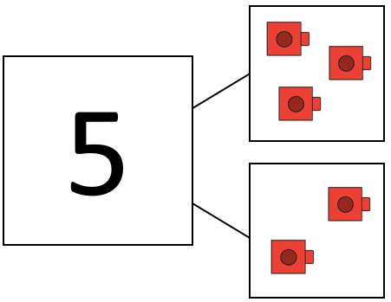

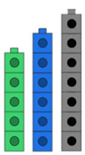
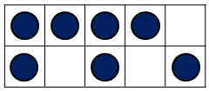
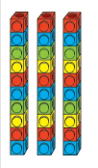

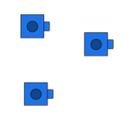



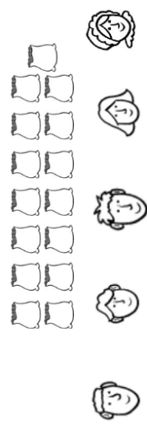

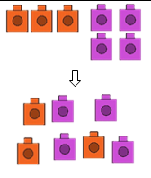

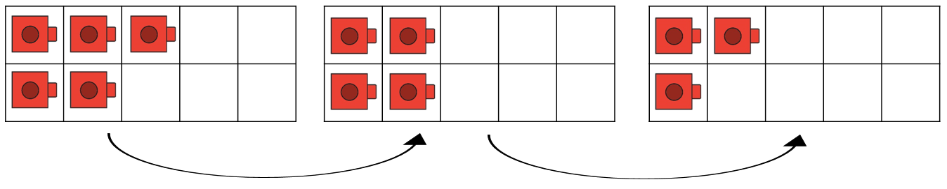
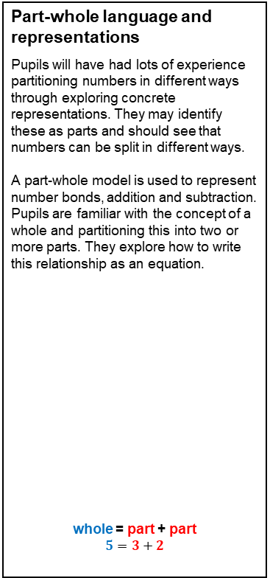
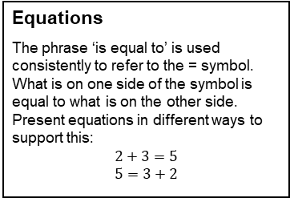
Year 1 Key Representations
Find out more…
Watch the Unit tutorial before planning each unit.
Read the planning guides for suggestions of representations.
Make use of PD videos on unit pages and Progression in Calculations page.
Representations of number
Pupils are most familiar with concrete representations of number within 20 which show one to one correspondence, such as cubes, counters, bead strings to 20 and other countable objects. They also recognise numerals and numbers to 20. A ten frame has been used to represent numbers and think about what this shows.
Part-whole language and representations
Pupils will have had lots of experience partitioning numbers in different ways through exploring concrete representations. They may identify these as parts and should see that numbers can be split in different ways.
A part-whole model is used to represent number bonds, addition and subtraction. Pupils are familiar with the concept of a whole and partitioning this into two or more parts. They explore how to write this relationship as an equation.
whole = part + part
$$5=3+2$$
There are seven counters. Seven is two more than five. Seven is three less than 10.
There are 11 cubes. 11 is one more than ten.
Ordering numbers
Pupils have explored a number of ways to order and compare numbers practically using representations including a number track and a number line, within 20. These representations are used to secure counting within 20 and stating one more / one less.
The whole is five. I can partition five into one part of three and one part of two.
Equations
The phrase ‘is equal to’ is used consistently to refer to the = symbol. What is on one side of the symbol is equal to what is on the other side. Present equations in different ways to support this:
$$2+3=5$$
$$5=3+2$$
Comparing numbers
Concrete representations are used to compare numbers, focusing on correct language use. The structure of the representation supports comparison: lining towers of cubes next to one another builds on one-to-one correspondence.
Representing numbers 11-20
Pupils say, read and write teen numbers. Pupils understand the ten and ones relationship of teen numbers, supported by representations.
There are three people in one train carriage and two people in another. One part is three and one part is two. The whole is five.
Five is less than seven. Five ones is fewer than seven ones.
Seven is greater than five.
There are fourteen cubes. This is written as 14. 14 is one ten and four ones.
Counting principles – conservation of number
A key number principle for developing addition and subtraction strategies is to understand that the same number of objects will always have the same value.
Counting principles – subitising
Subitising is the ability to identify a group of objects without the need to count. Pupils have explored this and should be confident in subitising up to five objects. Making use of patterns e.g. die faces, triangle shapes can support this.
Doubling and halving
Pupils have had opportunities to represent doubling and halving within 20 practically using manipulatives and other countable objects. Some facts may be recalled and pupils may connect this with equal groups.
Development of division
Pupils explore counting in equal groups using manipulatives or pictorial representations.
Pupils have explored the concept of equal and unequal grouping and sharing in context using concrete manipulatives.
There are three equal groups of 10. 10, 20, 30. There are 30 altogether.
There are still seven counters. The position has changed but no counters have been added or taken away.
Double three is six. Three plus three is equal to six.
Half of six is three.
Developing fraction language
The foundations for fractions have been laid through exploration of half full / half empty and associated descriptions. Pupils have also explored doubling and halving without linking specifically to fractions.
Addition and subtraction strategies
Pupils are familiar with addition and subtraction (taking away) using concrete and pictorial representations. A range of contexts for this have been explored. Pupils should be familiar with strategies including count all, count on and count back using representations.
15 cows can be grouped into five fields in this way. The groups are unequal.
I have four yellow cubes. I add two green cubes. I can count on from four: five, six. There are six cubes.
The bottle is half full.
The bottle is half empty.
I have five cubes. I can take away two: four, three. Five take away two is three.
I have three red cubes and four purple cubes. I can put them together and count the whole. There are seven cubes.
If 15 bags of grain are shared equally between five farmers, each farmer gets three bags.

Slide 2

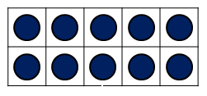
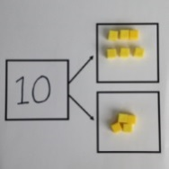
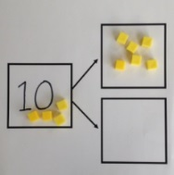
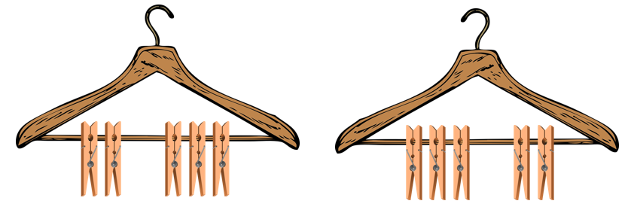
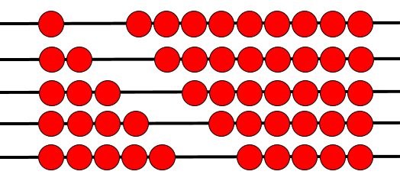
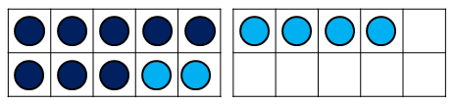


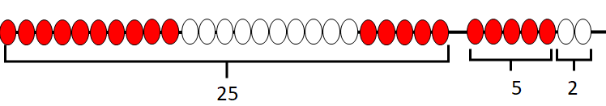
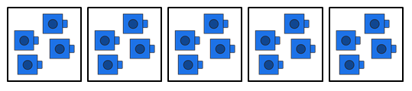
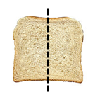
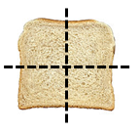

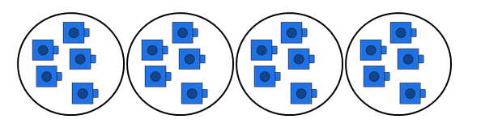

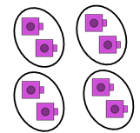

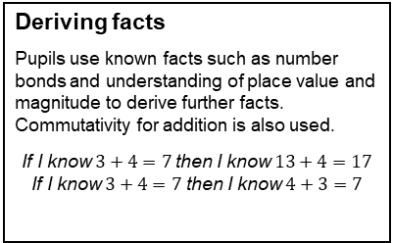
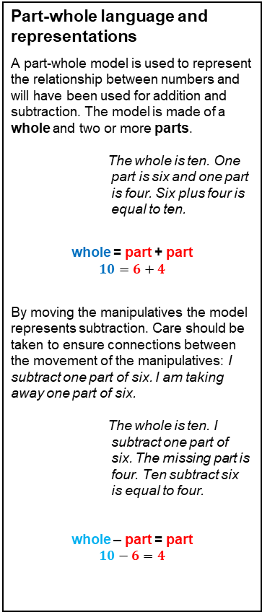

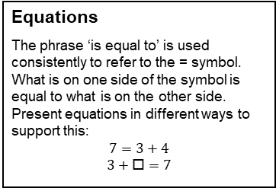
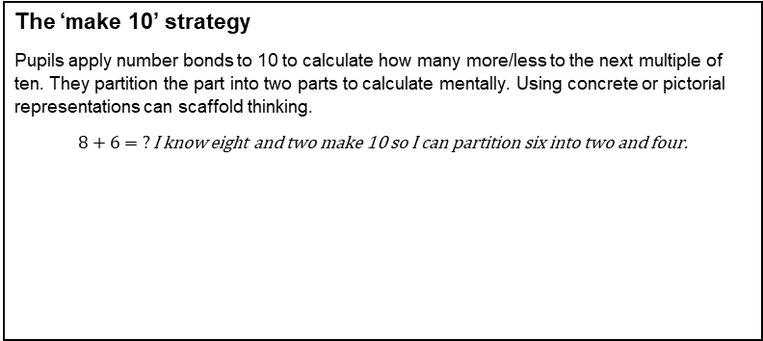
Year 2 Key Representations
Find out more…
Watch the Unit tutorial before planning each unit.
Read the planning guides for suggestions of representations.
Make use of PD videos on unit pages and Progression in Calculations page.
Representations of number
Pupils have primarily used counters, cubes and other discrete objects to represent number. Cubes have been used to support the process of regrouping – one ten is equal to ten ones. A ten frame supports this alongside number bonds for 10. Both are used to represent teen numbers.
Pupils have also encountered Dienes equipment to represent larger integers to 100. Counting in tens to identify these numbers has also been developed.
Part-whole language and representations
A part-whole model is used to represent the relationship between numbers and will have been used for addition and subtraction. The model is made of a whole and two or more parts.
The whole is ten. One part is six and one part is four. Six plus four is equal to ten.
whole = part + part
$$10=6+4$$
By moving the manipulatives the model represents subtraction. Care should be taken to ensure connections between the movement of the manipulatives: I subtract one part of six. I am taking away one part of six.
The whole is ten. I subtract one part of six. The missing part is four. Ten subtract six is equal to four.
whole – part = part
$$10−6=4$$
One ten is regrouped for ten ones. Ten ones is regrouped for one ten.
17 is one ten and seven ones.
Number lines
Number lines can be used to represent and compare numbers and can be used alongside a bead string. They demonstrate the continuous nature of the number system. Pupils have ordered numbers on a number line.
Equations
The phrase ‘is equal to’ is used consistently to refer to the = symbol. What is on one side of the symbol is equal to what is on the other side. Present equations in different ways to support this:
$$7=3+4$$
$$3+□=7$$
Number bond knowledge
Pupils should be increasingly fluent in number bond recall for all numbers to 10 and use representations to consider commutativity.
Deriving facts
Pupils use known facts such as number bonds and understanding of place value and magnitude to derive further facts. Commutativity for addition is also used.
If I know $3+4=7$ then I know $13+4=17$
If I know $3+4=7$ then I know $4+3=7$
Comparing numbers
Pupils have experienced a range of language to compare numbers.
Five is less than seven. Five ones is fewer than seven ones.
Seven is greater than five.
Six is between five and seven. It is after five and before seven.
The ‘make 10’ strategy
Pupils apply number bonds to 10 to calculate how many more/less to the next multiple of ten. They partition the part into two parts to calculate mentally. Using concrete or pictorial representations can scaffold thinking.
$8+6= ?$ I know eight and two make 10 so I can partition six into two and four.
Ten more / ten less
Pupils have explored ten more and ten less than numbers within 50 using manipulatives. They also skip count on and back in tens from different starting points. Mental recall of this can be developed in Maths Meetings.
Division by sharing / grouping
Pupils have been exposed to the concept of division within 20 through equal grouping and equal sharing. They have also explored unequal grouping and sharing. Pupils should explore the terms grouping and sharing and be familiar with both.
20 shared into five equal groups gives four in each group.
20 grouped into groups of five gives four groups.
Finding the difference
Pupils recognise that in a subtraction calculation where the numbers are close together in value, a count on strategy can be used to find the difference.
$32−25=?$ I can count on from 25 to find the difference. Five more is 30, two more is 32. The difference is seven.
Representing fractions
Pupils identify half and quarter of a shape and a quantity within 20 using practical experiences including equal sharing for a quantity. They are also familiar with half turns, linking this to half past on a clock face.
Doubling and halving
Pupils have had opportunities to represent doubling and halving within 20 using concrete and pictorial representations. This is connected to their understanding of half. Some facts will be recalled.
One quarter of eight is two.
Double three is six. Three plus three is equal to six.
Half of six is three. Six take away three is equal to three.
One half is one of two equal parts.
One quarter is one of four equal parts.
Half of six is three.

Slide 3
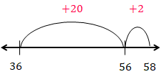
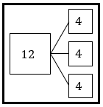
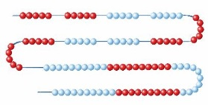
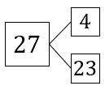
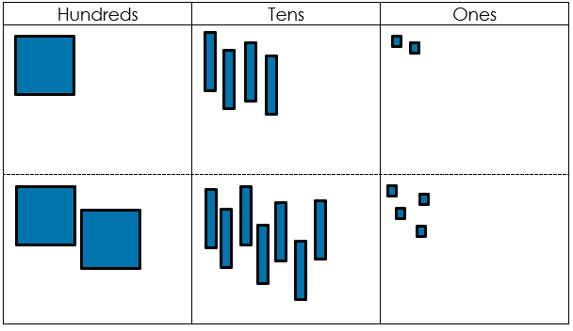
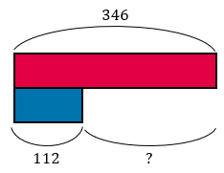


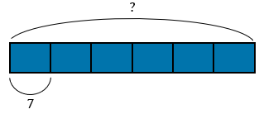
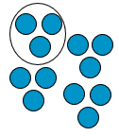


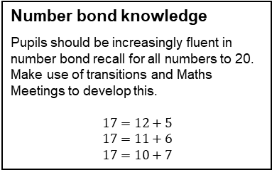
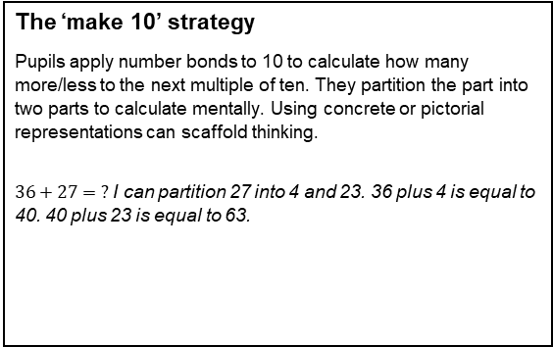
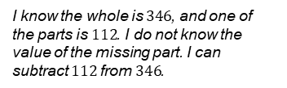

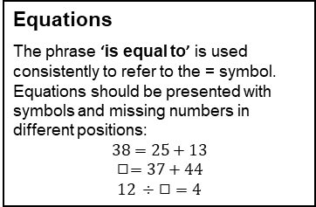





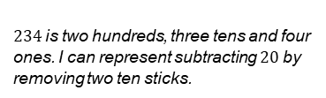

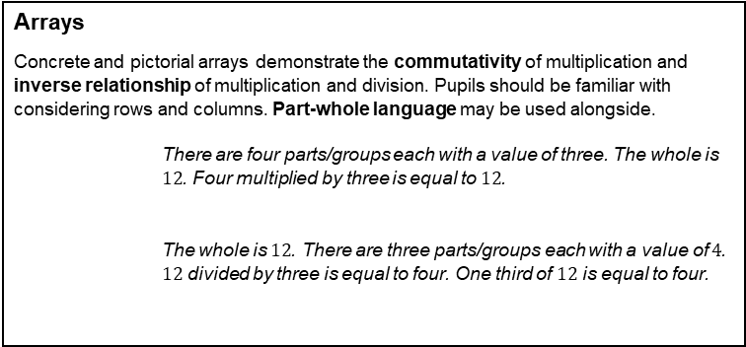
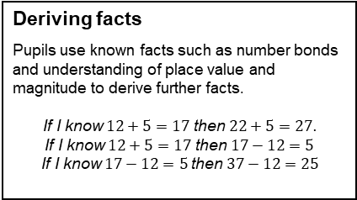


Year 3 Key Representations
Find out more…
Watch the Unit tutorial before planning each unit and read the Unit Narrative.
Read the planning guides for suggestions of representations.
Make use of PD videos on unit pages and Progression in Calculations page.
Explore the guidance for Year 3 representations.
Dienes equipment
An important resource for demonstrating the relative size of place value columns. Supports the process of regrouping – one ten is equal to ten ones, one hundred is equal to ten tens and so on. Can also be used to represent addition and subtraction with 2- and 3-digit integers.
Part-whole language and representations
A part-whole model is used to represent the relationship between numbers in all four operations. The model is made of a whole and two or more parts.
The whole is ten. One part is six and one part is four. Six plus four is equal to ten.
By moving the manipulatives the model represents subtraction.
The whole is ten. I subtract one part of six. The missing part is four. Ten subtract six is equal to four.
Multiplication, division and fractions of quantities can be represented using multiple equal parts.
One ten is regrouped for ten ones. Ten ones is regrouped for one ten.
$234$ is two hundreds, three tens and four ones. I can represent subtracting $20$ by removing two ten sticks.
Number lines
Number lines can be used to represent and compare numbers and can be used alongside a bead string. They demonstrate the continuous nature of the number system. When calculating, number lines may act as a jotting of the steps of a mental calculation and may begin ‘empty’ i.e. not have numbered divisions. Pupils will have experienced this most through adding tens then ones as shown. The use of number lines is extended during Year 3.
Equations
The phrase ‘is equal to’ is used consistently to refer to the = symbol. Equations should be presented with symbols and missing numbers in different positions:
$$38=25+13$$
$$◻=37+44$$
$$12 ÷ ◻ =4$$
Number bond knowledge
Pupils should be increasingly fluent in number bond recall for all numbers to 20. Make use of transitions and Maths Meetings to develop this.
$$17=12+5$$
$$17=11+6$$
$$17=10+7$$
Deriving facts
Pupils use known facts such as number bonds and understanding of place value and magnitude to derive further facts.
If I know $12+5=17$ then $22+5=27.$
If I know $12+5=17$ then $17−12=5$
If I know $17−12=5$then $37−12=25$
Bead strings
Bead strings help support the ordinality of number. They are repurposed e.g. beads have
the value 101-200 for representation when rounding.
There are three equal parts with a value of four. The whole is $12$. Three multiplied by four is equal to $12$. $12$divided into three equal parts is equal to four.
One third of $12$ is four.
The ‘make 10’ strategy
Pupils apply number bonds to 10 to calculate how many more/less to the next multiple of ten. They partition the part into two parts to calculate mentally. Using concrete or pictorial representations can scaffold thinking.
$36+27= ?$ I can partition 27 into 4 and 23. 36 plus 4 is equal to 40. 40 plus 23 is equal to 63.
Round and adjust
Pupils apply understanding of ordinality of number, recognising when a part or whole is close to a multiple of 10 e.g. 29, 32. They round before calculating, then adjust their answer accordingly. Concrete or pictorial models are used to represent this.
Place value charts
Place value charts have been used to represent two-digit numbers and can be used alongside concrete, pictorial and abstract representations of number to secure understanding of the positional aspect of the number system. Pupils have made use of place value charts when adding two 2-digit numbers and their use is extended in Year 3.
Bar models
Pictorial bar models and concrete Cuisenaire as bar models are used throughout the year and represent part-whole relationships and knowns and unknowns within problems. See PD videos for further exemplification.
$$−20$$
$$35−19=16$$
$$+1$$
$$15$$
$$16$$
$$35$$
Representing fractions
A range of concrete and pictorial representations are used for fractions including fractions of a whole, as part of a set of objects and as part of a quantity such as a length or volume. Pupils should be familiar with a range of representations.
Arrays
Concrete and pictorial arrays demonstrate the commutativity of multiplication and inverse relationship of multiplication and division. Pupils should be familiar with considering rows and columns. Part-whole language may be used alongside.
There are four parts/groups each with a value of three. The whole is $12$. Four multiplied by three is equal to $12$.
The whole is $12$. There are three parts/groups each with a value of $4$. $12$ divided by three is equal to four. One third of $12$ is equal to four.
I know the whole is $346$, and one of the parts is $112$. I do not know the value of the missing part. I can subtract $112$ from $346$.
numerator
$$\frac{1}{4}$$
One quarter of $12$ is three.
vinculum
One of four equal parts.
denominator
The value of each part is $7$ and there are $6$equal parts. The whole is unknown.
$$7×6=42$$
One quarter of a metre is $25$ cm.

Slide 4





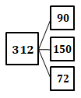
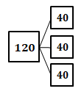

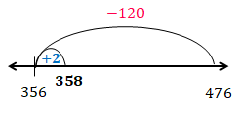
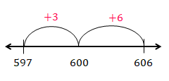

















Year 4 Key Representations
Find out more…
Watch the Unit tutorial before planning each unit and read the Unit Narrative.
Read the planning guides for suggestions of representations.
Make use of PD videos on unit pages and Progression in Calculations page.
Representations of number
Pupils are familiar with a range of concrete and pictorial representations of number with and without a place value chart. These are used to represent a number or calculation and should not be used as a counting tool. Pupils also make use of these when comparing numbers.
Part-whole language and representations
A part-whole model is used to represent the relationship between numbers in all four operations. The model is made of a whole and two or more parts.
Using multiple equal parts represents multiplicative relationships.
$234$ is two hundreds, three tens and four ones.
We know the whole is 312 and the value of one part is 190. We can use subtraction to find the missing part.
Number lines
Number lines can be used to represent and compare, demonstrating the continuous nature of the number system.
When calculating, number lines may act as a jotting of the steps of a mental calculation and may begin ‘empty’
i.e. not have numbered divisions. They are also used as a representation for rounding.
There are three parts. $90+150+72=312$
Number fact knowledge
Pupils know number bonds to 100 and apply to other multiples of 10. Pupils are increasingly fluent in a range of number facts including partitioning in different ways to discuss number.
136 is multiple of 4 because I can see 120 and 16 which are both multiples of 4.
They are also familiar with multiplication tables for 2, 3, 4, 5, 6, 8 and 10 and related division facts.
$6×8=48$ $48 ÷8=6$
Make use of transitions and Maths Meetings to develop this.
Deriving facts and inverse relationships
Pupils use known facts such as number bonds and understanding of place value and magnitude to derive further facts.
If I know $12+5=17$ then $222+5=227$
If I know $3×4=12$ then I know $6×4=24$
Inverse relationships have also been explored.
If I know $12+5=17$ then $17−12=5$
If I know $3×4=12$ then I know $12÷4=3$
Multiplication and division by powers of 10
Pupils have experienced the concept of ten times greater and smaller through exchanging Dienes, linking this to the apparent move of digits in a place value chart.
30 is ten times greater than 3.
Equations
The phrase ‘is equal to’ is used consistently to refer to the = symbol. Equations should be presented with symbols and missing numbers in different positions:
$$38=25+ 13$$
◻$=37+44$
$$12 ÷ ◻ =4$$
There are three equal parts with a value of 40. The whole is 120.
40 multiplied by 3 is equal to 120.
$120$divided into three equal parts is equal to 40.
Bar models
Pictorial bar models and concrete Cuisenaire as bar models are used to represent part-whole relationships and knowns and unknowns within problems in all four operations. See PD videos for further exemplification.
Mental strategies
Pupils have experienced a range of mental strategies for all four operations, including:
Applying number bonds to 10 and 100 to calculate how many more/less to the next multiple of ten, extending
to 100 and 1000, using the ‘make 10’ strategy.
Identifying numbers close to a multiple of ten or 100 e.g. 28, 201 and using a round and adjust strategy, including for
multiplication. “If I know 20 x 4 is 80, then 19 x 4 is 76”.
Identifying near doubles for addition. 43 and 45 can be seen as ‘double 43 plus two.'
Subtracting numbers close together in value, through counting on to find the difference.
$336+127= ?$ I can partition 27 into 123 and 4.
336 plus 4 is equal to 340. 340 plus 123 is equal to 463.
$$476−118=358$$
$606−597= ?$ I can count on from $597$ to $606$. The difference is $9$.
I know the whole is $346$, and one of the parts is $112$. I do not know the value of the missing part. I can subtract $112$ from $346$.
Representing fractions
A range of concrete and pictorial representations have been used for fractions including fractions of a whole, as part of a set of objects and as part of a quantity such as a length or volume. Pupils can apply these representations to comparing, finding simple equivalence and adding and subtracting with the same denominator, as well as fractions of sets or quantities.
Representing multiplicative relationships
Pupils have represented multiplicative relationships concretely and pictorially, primarily through arrays, Cuisenaire and bar models. A focus on equal parts, the number of equal parts and the value of each part supports understanding of commutativity and inverse relationships. The representations and language structures support written strategies.
One third is one of three equal parts
One third of $36$ is $12.$
numerator
$$\frac{1}{3}$$
There are four groups each with a value of 3.
There are three groups each with a value of 4.
I can see three, four times.
I can see four, three times.
12 divided into groups of 4 gives three groups
12 shared into four groups gives 3 in each group
The value of each part is seven and there are six equal parts. The whole is unknown. Six groups of seven is equal to 42. The whole is 42.
vinculum
$\frac{1}{3}$ is equivalent to $\frac{2}{6}$
denominator

Slide 5




















Year 5 Key Representations
Find out more…
Watch the Unit tutorial before planning each unit and read the Unit Narrative.
Read the planning guides for suggestions of representations.
Make use of PD videos on unit pages and Progression in Calculations page.
Representations of number
Pupils are familiar with a range of concrete and pictorial representations of number with and without a place value chart. These are used to represent a number or calculation and should not be used as a counting tool. Pupils have also experienced representing decimal numbers using manipulatives including repurposing Dienes equipment, understanding the base 10 relationship.
Part-whole language and representations
A part-whole model is used to represent the relationship between numbers in all four operations. The model is made of a whole and two or more parts.
The whole is ten. One part is six and one part is four. Six plus four is equal to ten.
Using multiple equal parts represents multiplication, division and fractions of quantities.
Close links are made between this and bar model representations.
This represents 2.34. It is 2 ones, 3 tenths and 4 hundredths.
2
3
4
$234$ is two hundreds, three tens and four ones.
Number lines
Number lines can be used to represent and compare, demonstrating the continuous nature of the number system. When calculating, number lines may act as a jotting of the steps of a mental calculation and may begin ‘empty’ i.e. not have numbered divisions. They are also used as a representation for rounding.
Number fact knowledge
Pupils have an increasing range of number facts. Pupils should know all multiplication tables and related division facts.
Pupils make increasing use of number facts when considering larger integers.
I know 132 is a multiple of 4 because I can partition it into 120 and 12. These are both multiples of 4.
There are three equal parts with a value of four. The whole is $12$. Three multiplied by four is equal to $12$. $12$divided into three equal parts is equal to four.
One third of $12$ is four.
Equations
The phrase ‘is equal to’ is used consistently to refer to the = symbol. Equations should be presented with symbols and missing numbers in different positions:
38=25+ 13
◻=37+44
12 ÷ ◻ =4
Deriving facts
Using known number bonds pupils derive more complex facts including deriving decimal bonds and facts.
I know $1+3=4$ so $0.1+0.3=0.4$
I know $13+12=25$ so $1300+1200=2500$
Using strategies
Pupils are familiar with columnar addition and subtraction, short multiplication and short division written strategies and have developed conceptual understanding through concrete and pictorial representations. These strategies can be applied to larger integers and decimals. See PD videos for further exemplification.
Pupils should make use of a range of strategies, considering efficiency.
Which strategy is most efficient here?
Bar models
Pictorial bar models and concrete Cuisenaire as bar models are used to represent part-whole relationships and knowns and unknowns within problems in all four operations. See PD videos for further exemplification.
Mental strategies
Pupils have experienced a range of mental strategies for all four operations, including:
Applying number bonds to 10 and 100 to calculate how many more/less to the next multiple of ten, extending
to 100 and 1000, using the ‘make 10’ strategy.
Identifying numbers close to a multiple of ten or 100 e.g. 28, 201 and using a round and adjust strategy, including for
multiplication. “If I know 20 x 4 is 80, then 19 x 4 is 76”.
Identifying near doubles for addition. 43 and 45 can be seen as ‘double 43 plus two.
Subtracting numbers close together in value, through counting on to find the difference.
Once secure, these can be applied to larger integers and decimal values.
$336+127= ?$ I can partition 27 into 123 and 4.
336 plus 4 is equal to 340. 340 plus 123 is equal to 463.
$$476−118=358$$
$606−597= ?$ I can count on from $597$ to $606$. The difference is $9$.
I know the whole is $346$, and one of the parts is $112$. I do not know the value of the missing part. I can subtract $112$ from $346$.
Representing fractions
Pupils will have represented unit, non-unit and improper fractions in a variety of ways including area, part of a set and on a number line. Through representations they understand equivalence. They have identified non-unit fractions of quantities.
Representing multiplicative relationships
Pupils have used an increasing range of models to represent multiplicative relationships and use these to describe inverse relationships and commutativity.
$$\frac{1}{4}=\frac{3}{12}$$
$$\frac{8}{5}=1\frac{3}{5}$$
numerator
There are three rows with a value of four. There are four columns with a value of 3.
$$3×4=12 4×3=12$$
$12÷4=3 12÷3=4$
Two thirds of $120$ is $40$
$$\frac{1}{4}$$
The value of each part is seven and there are six equal parts. The whole is unknown. Six groups of seven is equal to 42. The whole is 42.
vinculum
Three groups of four are equal to 12.
Four groups of three are equal to 12.
denominator
$$3$$
$$4$$

